Slide 1



INSTITUTE: UIE (AIT-CSE)
CSS21: B.E. CSE (H) with specialization in Artificial Intelligence & Machine Learning
Advanced Machine Learning (20CSF-349)
Chapter 1.1: Linear Regression
Lecture 3 & 4: Multiple Linear Regression & Multicollinearity
By: Mr. Siddharth Kumar
DISCOVER . LEARN . EMPOWER

Slide 2
Advanced Machine Learning
Course Outcome
CO | Title
1 | Have a good understanding of the fundamental issues and challenges of machine learning: data, model selection, model complexity, etc.
2 | Appreciate the underlying mathematical relationships within and across Machine Learning algorithms and the paradigms of supervised and un-supervised learning
3 | Design and implement various machine learning algorithms in a range of real-world applications.
4 | Design and evaluate intelligent expert models for perception and prediction using machine learning algorithms
5 | Analyze and make use of machine learning algorithms-based applications using performance

Slide 3
What is Multiple Linear Regression?
In the previous topic, we have learned about Simple Linear Regression, where a single Independent/Predictor(X) variable is used to model the response variable (Y). But there may be various cases in which the response variable is affected by more than one predictor variable; for such cases, the Multiple Linear Regression algorithm is used.
Moreover, Multiple Linear Regression is an extension of Simple Linear regression as it takes more than one predictor variable to predict the response variable. We can define it as:
“Multiple Linear Regression is one of the important regression algorithms which models the linear relationship between a single dependent continuous variable and more than one independent variable.”
Some key points about Multiple Linear Regression :
For Multiple Linear Regression, the dependent or target variable(Y) must be the continuous/real, but the predictor or independent variable may be of continuous or categorical form.
Each feature variable must model the linear relationship with the dependent variable.
MLR tries to fit a regression line through a multidimensional space of data-points.

Slide 4
Regression models are used to describe relationships between variables by fitting a line to the observed data. Regression allows you to estimate how a dependent variable changes as the independent variable(s) change.
Assumptions for Multiple Linear Regression:
Homogeneity of variance (homoscedasticity): the size of the error in our prediction doesn’t change significantly across the values of the independent variable.
Independence of observations: the observations in the dataset were collected using statistically valid methods, and there are no hidden relationships among variables.
Normality: The data follows a normal distribution.
Linearity: the line of best fit through the data points is a straight line, rather than a curve or some sort of grouping factor.

Slide 5
Multiple linear regression is used to estimate the relationship between two or more independent variables and one dependent variable. You can use multiple linear regression when you want to know:
How strong the relationship is between two or more independent variables and one dependent variable (e.g. how rainfall, temperature, and amount of fertilizer added affect crop growth).
The value of the dependent variable at a certain value of the independent variables (e.g. the expected yield of a crop at certain levels of rainfall, temperature, and fertilizer addition).
Example
Question: You are a public health researcher interested in social factors that influence heart disease. You survey 500 towns and gather data on the percentage of people in each town who smoke, the percentage of people in each town who bike to work, and the percentage of people in each town who have heart disease.
Justification: Because you have two independent variables and one dependent variable, and all your variables are quantitative, you can use multiple linear regression to analyze the relationship between them.

Slide 6
How to perform a Multiple Linear Regression
The formula for a multiple linear regression is:
y = the predicted value of the dependent variable
B₀ = the y-intercept (value of y when all other parameters are set to 0)
B₁X₁ = the regression coefficient (B₁) of the first independent variable (X₁) (a.k.a. the effect that increasing the value of the independent variable has on the predicted y value)
… = do the same for however many independent variables you are testing
B_{n}X_{n} = the regression coefficient of the last independent variable
ε = model error (a.k.a. how much variation there is in our estimate of y)

Slide 7
To find the best-fit line for each independent variable, multiple linear regression calculates three things:
The regression coefficients that lead to the smallest overall model error.
The t-statistic of the overall model.
The associated p-value (how likely it is that the t-statistic would have occurred by chance if the null hypothesis of no relationship between the independent and dependent variables was true).
It then calculates the t-statistic and p-value for each regression coefficient in the model.
Below are the main steps of deploying the MLR model:
Data Pre-processing Steps
Fitting the MLR model to the training set
Predicting the result of the test set

Slide 8
Multicollinearity
Multicollinearity happens when independent variables in the regression model are highly correlated to each other. It makes it hard to interpret of model and also creates an overfitting problem. It is a common assumption that people test before selecting the variables into the regression model.
The use of multiple regression model often depends on the estimates of the individual regression coefficients. Some examples of inferences that are frequently made include.
Identifying the relative effects of the regression variables,
Prediction and/or estimation, and
Selection of an appropriate set of variables for the model.
Multicollinearity is a case of multiple regression in which the predictor variables are themselves highly correlated. One of the purposes of a regression model is to find out to what extent the outcome (dependent variable) can be predicted by the independent variables. The strength of the prediction is indicated by R², also known as variance explained or strength of determination.

Slide 9
Why Multicollinearity is a problem?
When independent variables are highly correlated, change in one variable would cause change to another and so the model results fluctuate significantly. The model results will be unstable and vary a lot given a small change in the data or model. This will create the following problems:
It would be hard for you to choose the list of significant variables for the model if the model gives you different results every time.
Coefficient Estimates would not be stable and it would be hard for you to interpret the model. In other words, you cannot tell the scale of changes to the output if one of your predicting factors changes by 1 unit.
The unstable nature of the model may cause overfitting. If you apply the model to another sample of data, the accuracy will drop significantly compared to the accuracy of your training dataset.

Slide 10
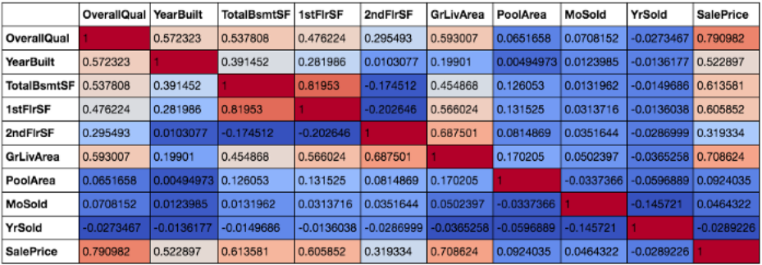
How to check whether Multi-Collinearity occurs?
The first simple method is to plot the correlation matrix of all the independent variables.
I used the housing data from the Kaggle. The goal of the competition is to use the housing data input to correctly predict the sales price. I have selected a few numerical variables to be included in my model here.
Regression Line

Slide 11
After plotting the correlation matrix and color scaling the background, we can see the pairwise correlation between all the variables. I have included the dependent variable ‘SalePrice’ here as well. This is because it is a secret trick for me when I try to select the independent variables to be included in the model.
Back to the Multi-Collinearity issue, we can see that from the correlation matrix, quite a few variables are correlated to each other. There is one pair of independent variables with more than 0.8 correlation which are total basement surface area and first-floor surface area. Houses with larger basement areas tend to have bigger first-floor areas as well and so a high correlation should be expected.
The second method to check multi-collinearity is to use the Variance Inflation Factor(VIF) for each independent variable. It is a measure of multicollinearity in the set of multiple regression variables. The higher the value of VIF the higher correlation between this variable and the rest.
If the VIF value is higher than 10, it is usually considered to have a high correlation with other independent variables.

Slide 12
How to fix the Multi-Collinearity issue?
Variable Selection: The most straightforward method is to remove some variables that are highly correlated to others and leave the more significant ones in the set. For example, when we plot the correlation matrix with ‘SalePrice’ included, we can see that Overall Quality and Ground living area have the two highest correlations with the dependent variable ‘SalePrice’ and thus I will try to include them in the model.
Variable Transformation: The second method is to transform some of the variables to make them less correlated but still maintain their feature. What do I mean by this? In the housing model example, I can transfer ‘years of built’ to ‘age of the house’ by subtracting current year by years of built. For example, if the year of building is1994, then the age of the house is 2020–1994=26 years.
Principal Component Analysis (PCA): It is commonly used to reduce the dimension of data by decomposing data into a number of independent factors. It has many applications like simplifying model calculation by reducing the number of predicting factors. However, in our case here, we will just use the character of variable independence for PCA to remove the multi-collinearity issue in the model.

Slide 13
References
T1: Mitchell T.M., Machine Learning, McGraw Hill (1997).
T2: Andreas C. Miller, Sarah Guido, Introduction to Machine Learning with Python, O’REILLY (2001).
Notes:
Introduction to Cyber Security (simplilearn.com)

Slide 14

THANK YOU

